Slide 1

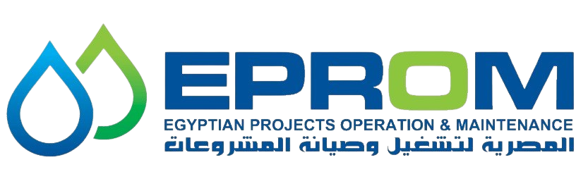
Asset Integrity Excellence
Transforming Risk into Reliability
Gap Analysis · Physical Barrier Assessment · RBI · RCM · System Development · Implementation · Audit
CCPS · API · ASME · ISO · EGPC

Slide 2
About EPROM
Egyptian Projects Operation & Maintenance
EPROM delivers world-class Asset Integrity services to the oil & gas, refining, and petrochemical industries. Our team of seasoned engineers and consultants brings decades of combined expertise in Process Safety Management, Risk-Based Inspection, Reliability Centered Maintenance, and comprehensive integrity management systems.
We partner with leading energy companies across Egypt and the MENA region to build safer, more reliable, and sustainable operations through a structured three-phase approach.
3
10+
50+
100%
Phased
Approach
Major
Clients
Standards
Covered
Compliance
Focus

Slide 3
The Asset Integrity Journey
A structured, phased approach to building world-class asset integrity
01
02
03
Gap Analysis &
Physical Barrier Assessment
System Development &
Technical Studies
Implementation, Audit
& Sustainability
Independent PSM gap analysis to identify hidden risks, performance gaps, and integrity weaknesses.
Comprehensive development of AIM systems, inspection programs, RBI/RCM studies, and corrosion management.
End-to-end implementation, training, compliance verification, KPI monitoring, and continuous improvement.

Slide 4
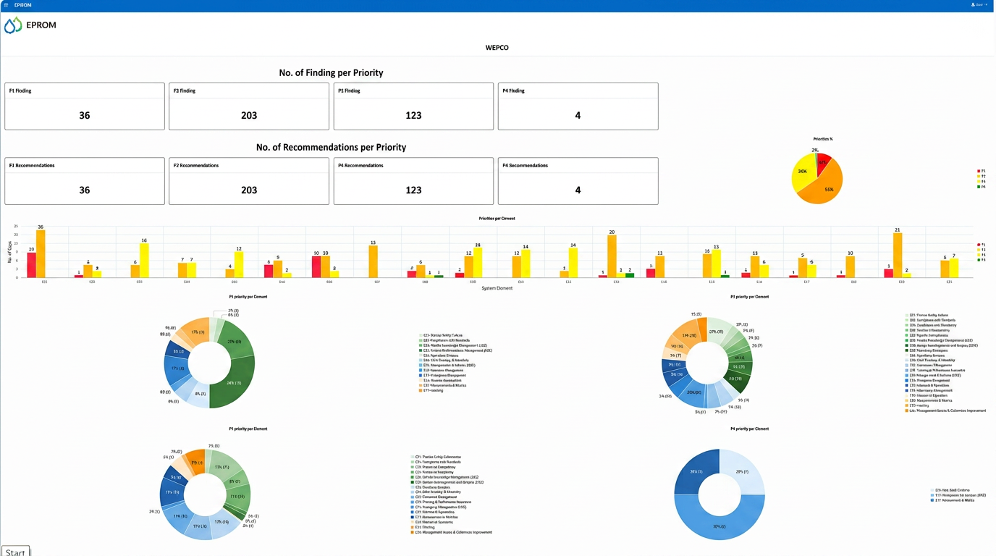
PHASE 01
Gap Analysis & Physical Barrier Assessment
EPROM performs independent and unbiased PSM Gap Analysis and Physical Barrier Assessments to identify hidden risks, performance gaps, integrity weaknesses, and deficiencies across your operations.
Document Review
Employee Interviews
Site Visits
Comprehensive review of existing procedures, policies, inspection records.
Structured interviews with operators, engineers, and management.
On-site walkthroughs and field inspections to assess conditions.
Key Deliverables
✓ Gap Analysis Report
✓ Physical Barrier Assessment Report
✓ Compliance Assessment
✓ Risk Ranking
✓ Improvement Roadmap
✓ Executive Dashboard
EPROM Software (Risk Lens)

Slide 5
PHASE 02
System Development & Technical Studies
10.1
10.2
10.3
System Documents
Inspection Deliverables
RCM & RBI Deliverables
10.4
10.5
10.6
QA/QC Deliverables
Instrumentation & Control
Corrosion Management
10.7
10.8
10.9
Electrical Deliverables
Maintenance General
Rotating Deliverables
10.10
Condition Monitoring
Comprehensive development of procedures, systems, and technical studies across every discipline of asset integrity management.

Slide 6
SPECIALIZED SERVICE
Risk Based Inspection RBI
From Corrosion Understanding to Optimized Inspection Planning
Corrosion Study Deliverables
Risk Assessment & Inspection Planning
▸ Corrosion Circuit Marked-Up PFDs
▸ Corrosion Circuit Tables
▸ Corrosion Study Sheets
▸ Marked-Up P&IDs
▸ Injection & Mixing Points
▸ Soil-to-Air Interfaces
▸ Dead Legs & Damage Mechanisms
▸ Equipment & Piping Risk Ranking
▸ Inspection Plans & Tasks
▸ Inspection Intervals
▸ Risk Distribution Analysis
▸ PRV Pop Test Due Dates
▸ Integrity Operating Windows (IOW)

Slide 7
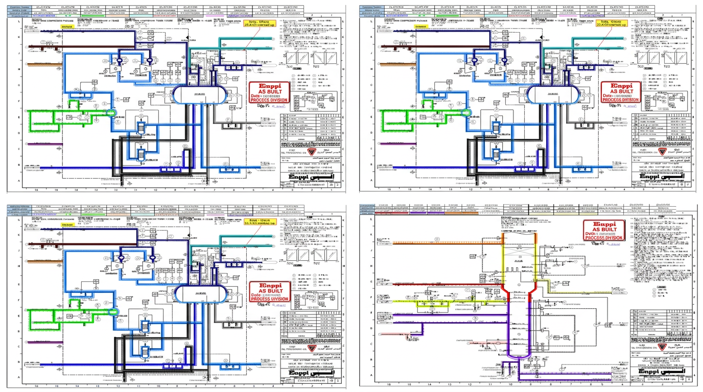
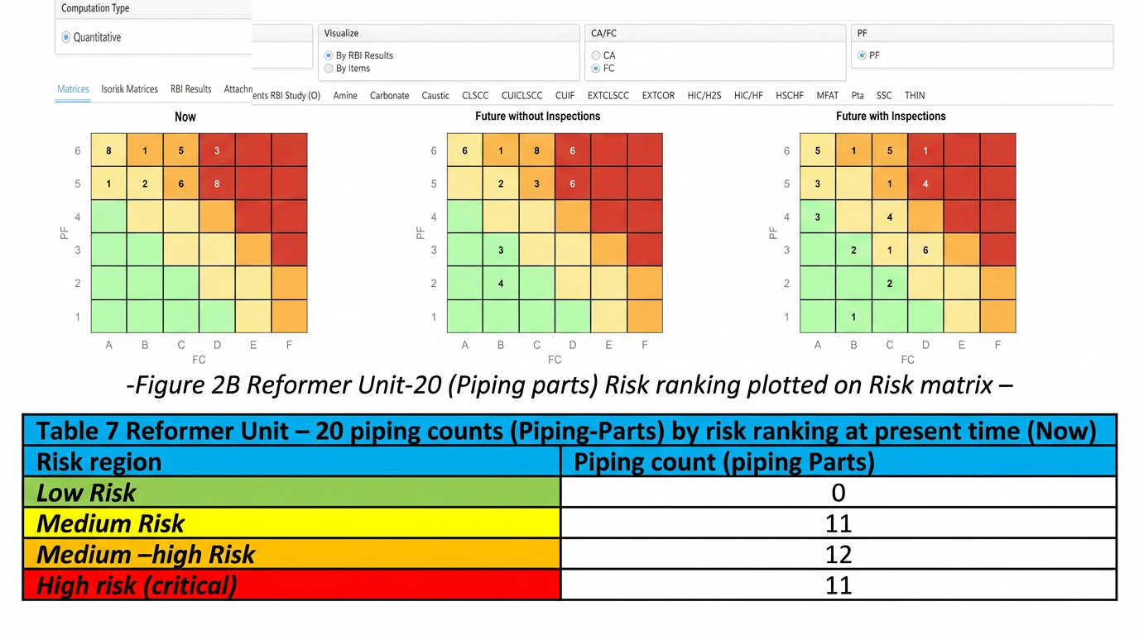
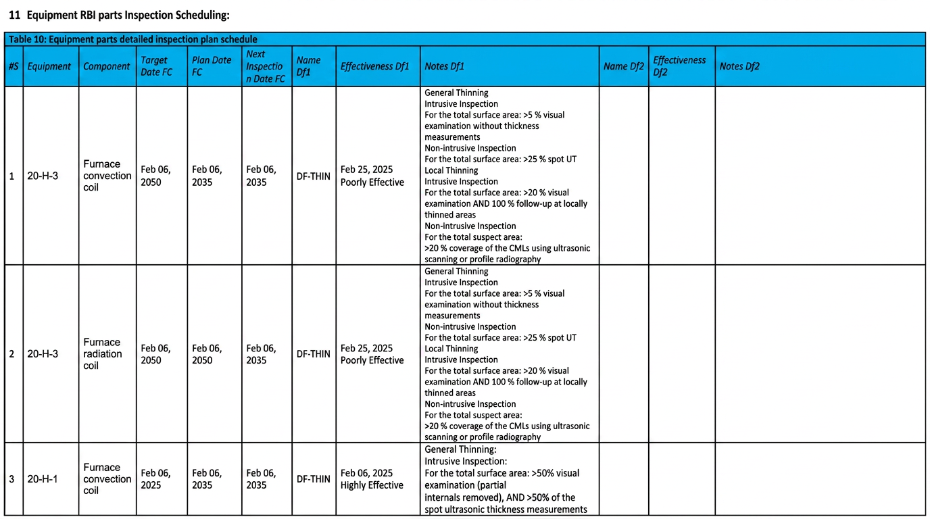
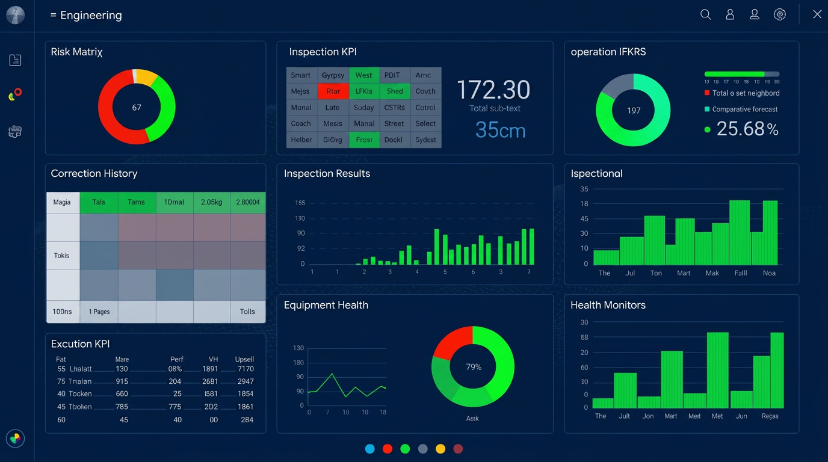
RBI Deliverable Samples
Marked P&ID / PFD with Corrosion Circuits
Risk Ranking Matrix & Distribution
Inspection Scheduling
Integrity Dashboard

Slide 8
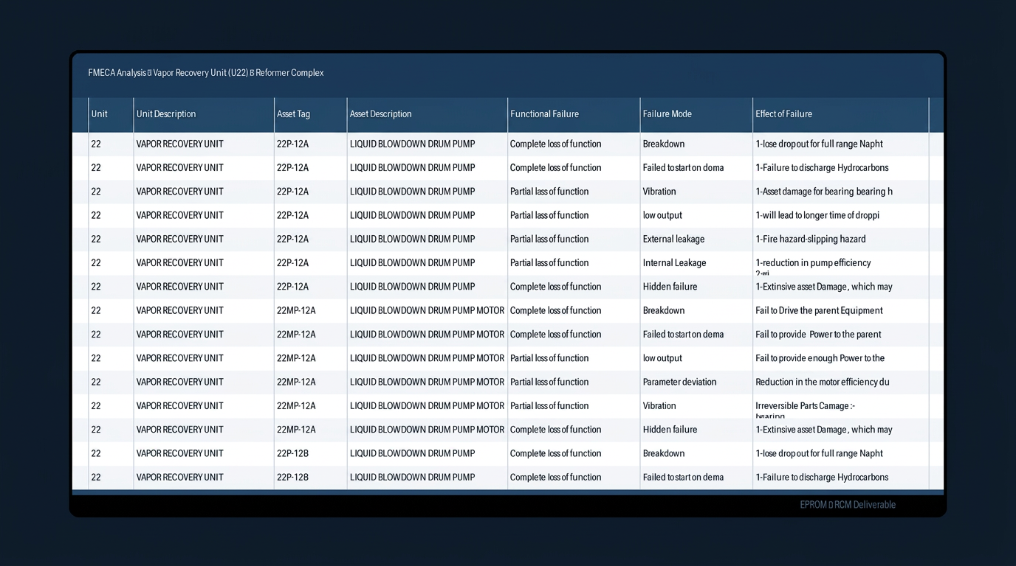
SPECIALIZED SERVICE
Reliability Centered Maintenance RCM
Transforming Maintenance from Reactive to Reliability-Driven
Layer One RCM Study Report
Layer Two Criticality Analysis
FMECA Sheets
Failure Modes Analysis
Equipment Criticality
Maintenance Optimization
Predictive Maintenance
Spare Parts Criticality
Reliability Improvement
FMECA Analysis Sheet — RCM Deliverable

Slide 9
PHASE 03
Implementation, Audit & Sustainability
End-to-end support from implementation through sustainable operations and continuous improvement.
Procedure Implementation
Training Programs
Audit Programs
Compliance Verification
Deploying developed systems and procedures across operations.
Competency-based training for operations and maintenance teams.
Systematic auditing to ensure compliance and effectiveness.
Independent verification against standards and requirements.
KPI Monitoring
Dashboarding
Continuous Improvement
Governance & Reporting
Tracking leading and lagging indicators for asset performance.
Real-time visibility into integrity status and metrics.
Sustainability through ongoing optimization cycles.
Executive reporting and governance frameworks.

Slide 10
Built Around International Standards
Every EPROM deliverable is aligned with global best practices and regulatory requirements.
Pipeline Integrity
Asset Integrity & MI
Pressure Equipment
API 1160, API RP 1173, ASME B31.8S, PHMSA, NACE SP0502
CCPS, ISO 55001, API RP 580/581/584/571, API 579-1
API 510, API 570, API 653, API 576/577/578, ASME VIII
Corrosion & CP
Barrier Management
Additional Standards
NACE SP0169, NACE MR0175, API RP 583/571, AMPP
IOGP Report 544, IOGP, COS, CCPS, IChemE
IEC 61511/61508, NFPA, ISO 14224/31000/45001

Slide 11
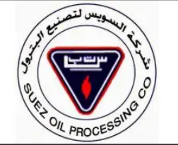

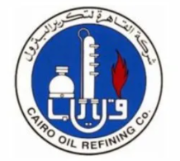
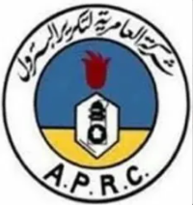
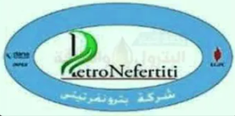
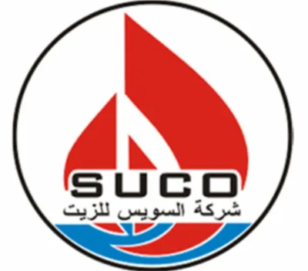
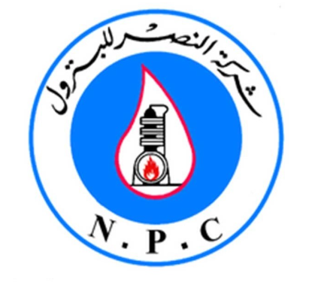

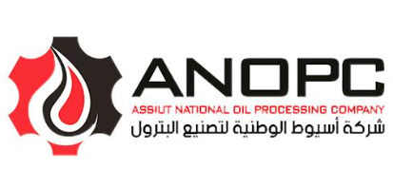

Trusted by Leading Energy Companies
SOPC
WEPCO
CORC
APRC
PetroNefertiti
Suez Oil Processing Company
Western Desert Operating Petroleum Co.
Cairo Oil Refining Company
Amrya Petroleum Refining Company
PetroNefertiti
SUCO
NPC
BADR-1
ANOPC
GASCO
Suez Canal Operating Company
Nasr Petroleum Company
Badr-1 Petroleum Company
Assiut National Oil Processing Company
Egyptian Natural Gas Company

Slide 12
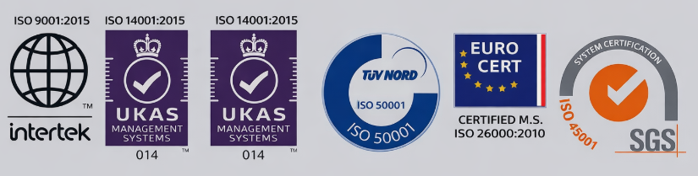
Partner with EPROM to Build Safer,
More Reliable & Sustainable Operations
Let our team of asset integrity experts help you achieve operational excellence, regulatory compliance, and long-term reliability.
Email: Mikhatab@Eprom.Com.Eg | mmostafa@Eprom.Com.Eg
Phone: +20 10 05803447
WhatsApp: +201005803447

